Slide 1




Ai in Pharmacy
gu.edu.eg

Slide 2













Students
Mennatallah
Marina
Mariam
Nayra
Abdelrahman
Reem
Yomna
Ashraf
Khaled
Youssef
Hassan

Slide 3
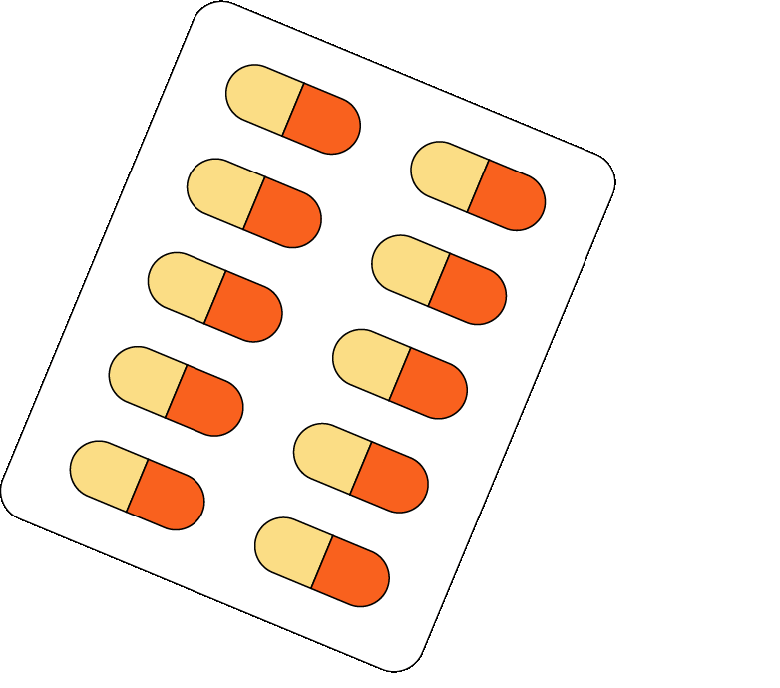
Introduction to AI in pharmacy
Artificial Intelligence (AI) is transforming various fields, including pharmacy. Here’s how AI can relate to pharmacy:
1.Medication Management:
AI can help pharmacists manage medication inventory, predict medication demand, and identify potential drug interactions and adverse reactions. This ensures that patients receive the correct medications and dosages
2.Personalized Medicine:
By analyzing patient data, including medical history and genetic information, AI can assist in creating personalized treatment plans. This helps in identifying the most effective medications for individual patients

Slide 4
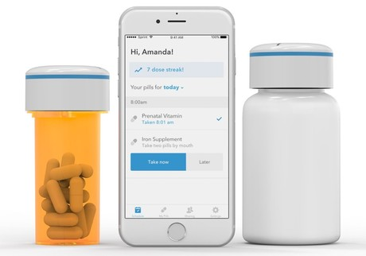
Introduction to AI in pharmacy
3.Patient Monitoring:
AI can monitor patient adherence to medication regimens and health outcomes. This allows pharmacists to intervene early if there are signs of non-adherence or potential health issues
4.Streamlining Operations:
AI can automate routine tasks such as medication dispensing and inventory management, reducing errors and freeing up pharmacists to focus on patient care

Slide 5

Python
1. Fundamentals
Syntax: Python uses simple and readable syntax. For example, to print "Hello, World!", you just write:
print("Hello, World!")
Variables: You can store data in variables. For example:
drug_name = "Aspirin"
dosage_mg = 500
2. Data Types
Strings: Text data, e.g., "Aspirin".
Numbers: Integers and floats, e.g., 500 or 12.5.
Booleans: True or False values, e.g., is_prescribed = True.
3. Control Flow
If Statements: Make decisions in your code.
if dosage_mg > 100:
print("High dosage")
else:
print("Normal dosage")
Loops: Repeat actions.
for i in range(5):
print(i)
4. Functions
Defining Functions: Reusable blocks of code.
def calculate_dosage(weight_kg, dosage_per_kg):
return weight_kg * dosage_per_kg

Slide 6
Python
5. Libraries
Pandas: For data manipulation and analysis.
import pandas as pd
df = pd.read_csv("clinical_trials.csv")
Matplotlib/Seaborn: For data visualization.
import matplotlib.pyplot as plt
import seaborn as sns
sns.histplot(df['response_time'])
plt.show()
6. File Handling
Reading/Writing Files: Handle data files.
with open("data.txt", "r") as file:
data = file.read()

Slide 7
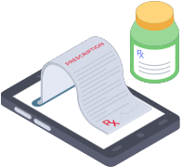
Libraries
1. Pandas
Purpose: Data manipulation and analysis.
Usage: Handling large datasets, cleaning data, and performing complex data operations.
Example: Reading clinical trial data from a CSV file.
import pandas as pd
df = pd.read_csv("clinical_trials.csv")
2. NumPy
Purpose: Numerical computing.
Usage: Performing mathematical operations on large, multi-dimensional arrays and matrices.
Example: Calculating the mean dosage of a drug.
import numpy as np
dosages = np.array([500, 250, 1000, 750])
mean_dosage = np.mean(dosages)
3. SciPy
Purpose: Scientific and technical computing.
Usage: Advanced mathematical functions, optimization, and signal processing.
Example: Solving differential equations related to drug kinetics.
from scipy.integrate import odeint
4. Matplotlib
Purpose: Data visualization.
Usage: Creating static, animated, and interactive visualizations.
Example: Plotting patient response trends.
import matplotlib.pyplot as plt
plt.plot(dates, response_times)
plt.show()
5. Seaborn
Purpose: Statistical data visualization.
Usage: Creating attractive and informative statistical graphics.
Example: Visualizing the distribution of drug efficacy.
import seaborn as sns
sns.histplot(df['efficacy'])
plt.show()
6. Biopython
Purpose: Computational biology and bioinformatics.
Usage: Working with biological data, such as DNA sequences and protein structures.
Example: Analyzing genetic data related to drug response.
from Bio import SeqIO
7. PyPharm
Purpose: Financial, logistical, and compliance analysis in pharmacy settings.
Usage: Handling common pharmacy data types like NDC and price files

Slide 8
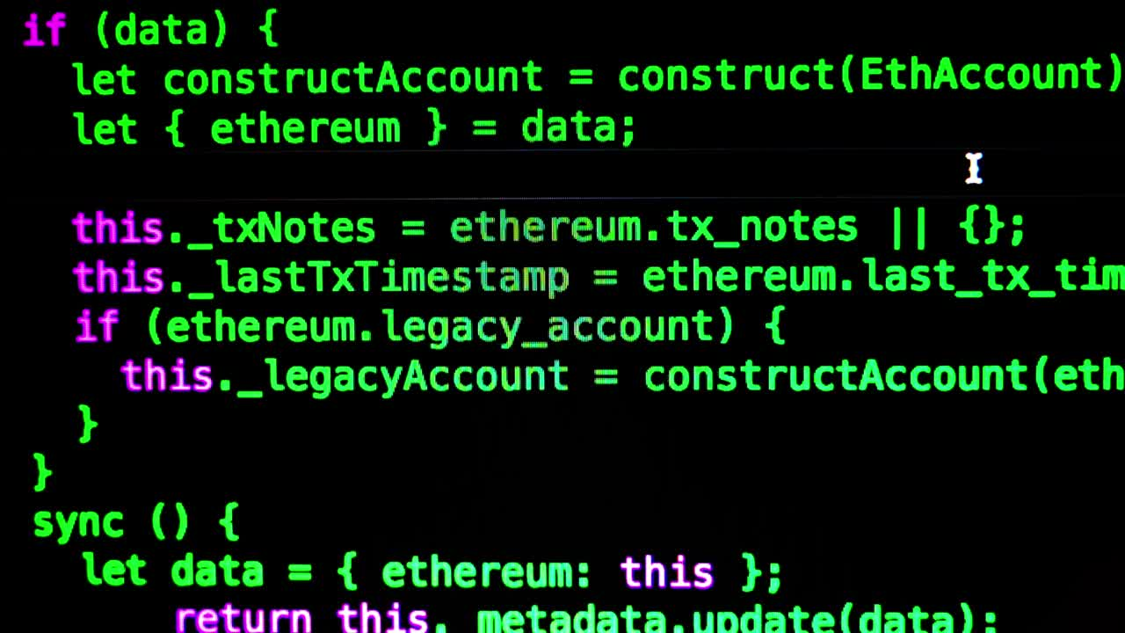
Code time

Slide 9
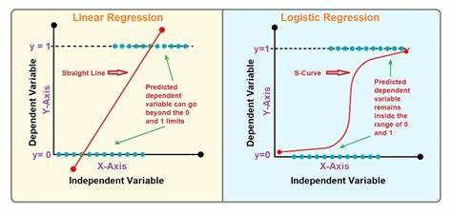
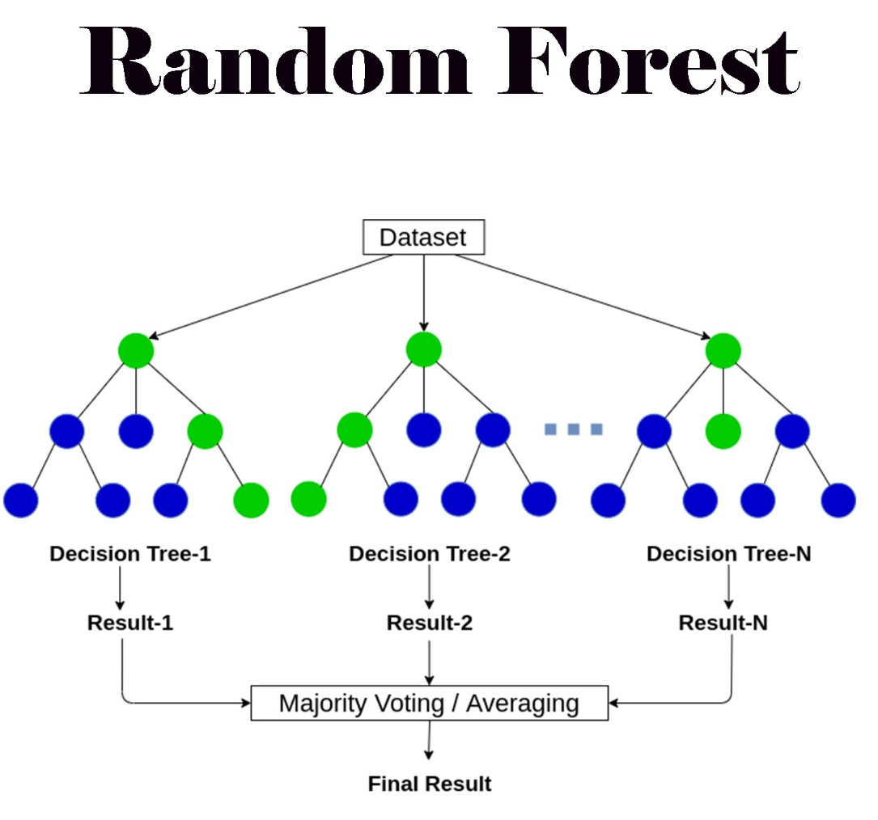
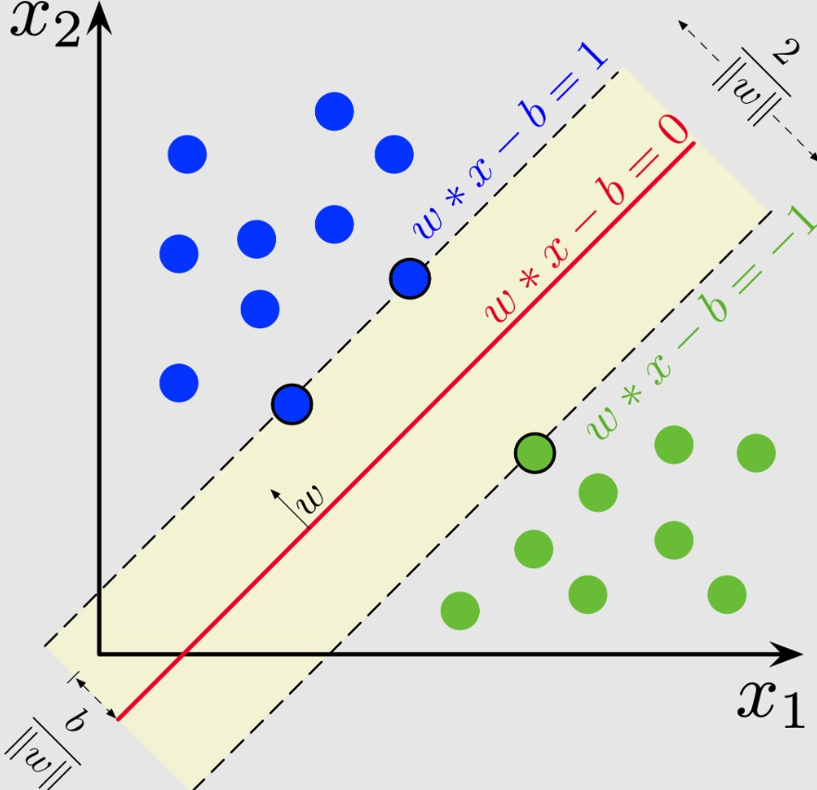
Algorithms

Slide 10
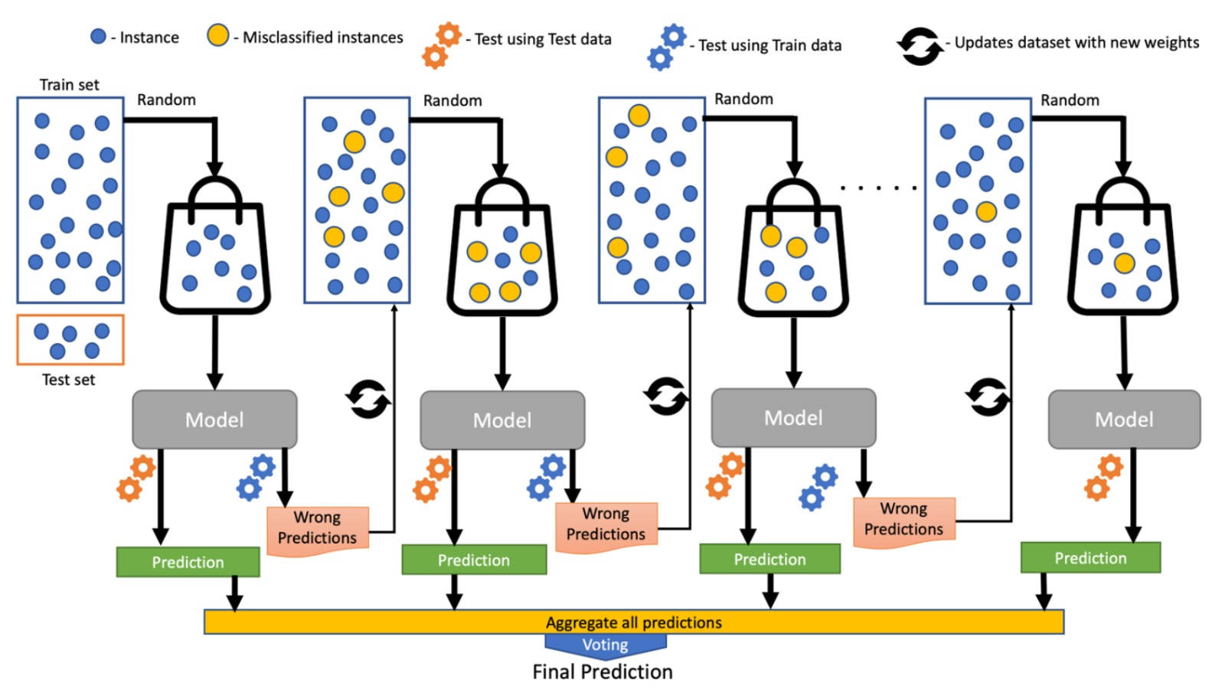
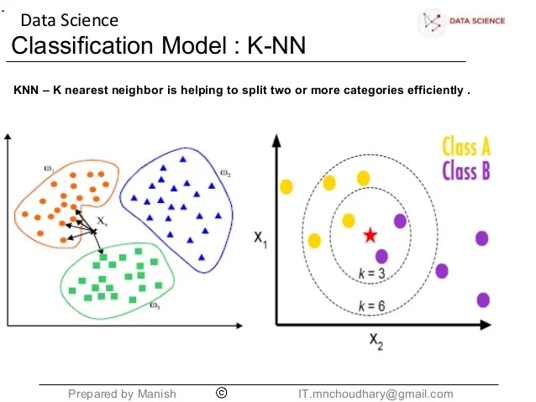
Algorithms

Slide 11
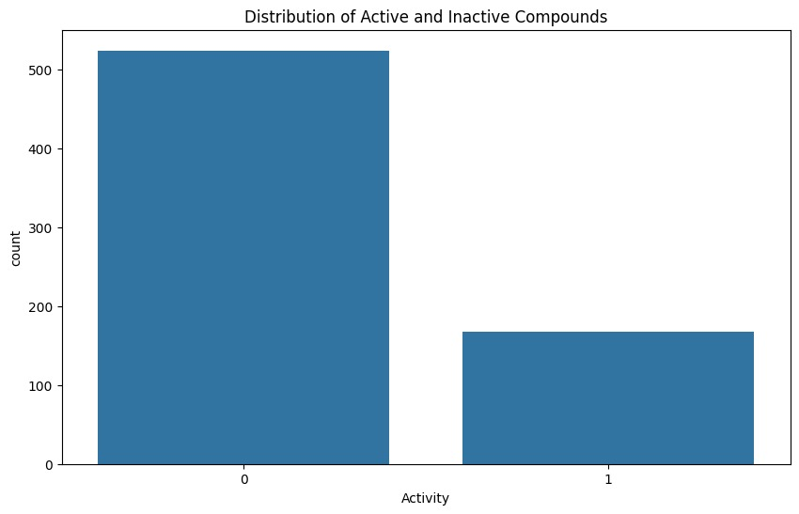
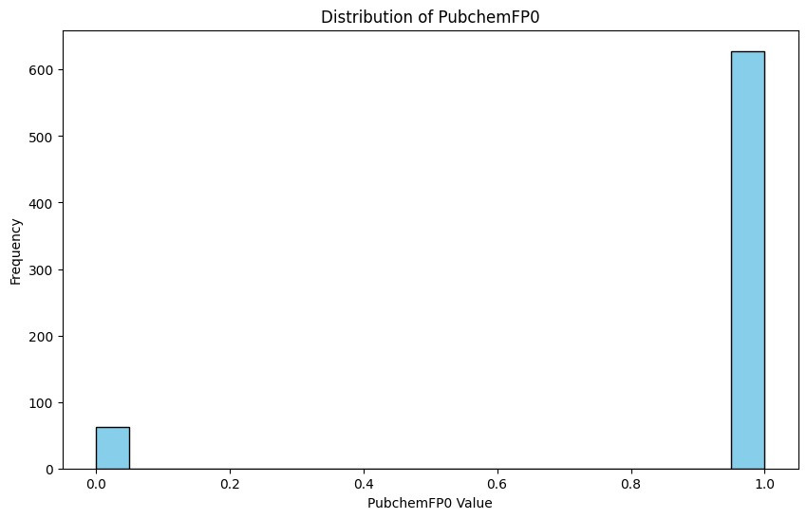
Data visualization
Data Description:
Dataset Shape: (691, 882)
Column Names: Index(['IC50 (nM)', 'PubchemFP0', 'PubchemFP1', 'PubchemFP2', 'PubchemFP3', 'PubchemFP4', 'PubchemFP5', 'PubchemFP6', 'PubchemFP7', 'PubchemFP8'], dtype='object')

Slide 12
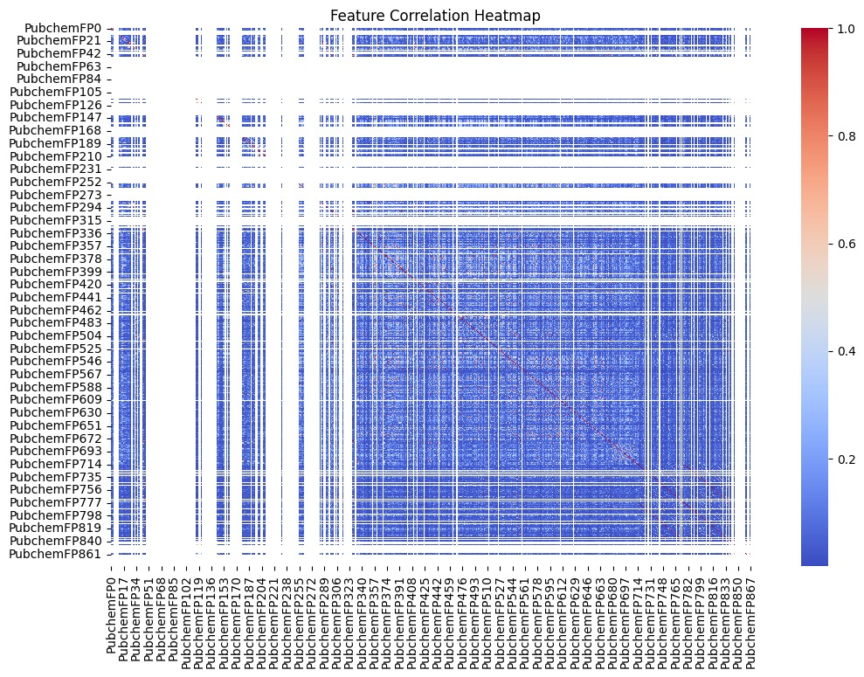
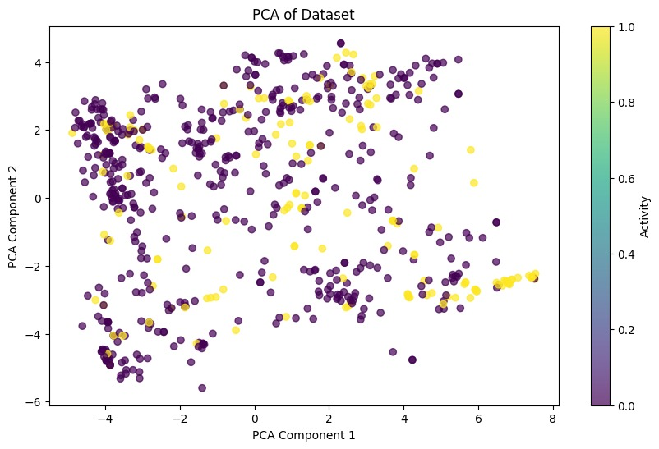
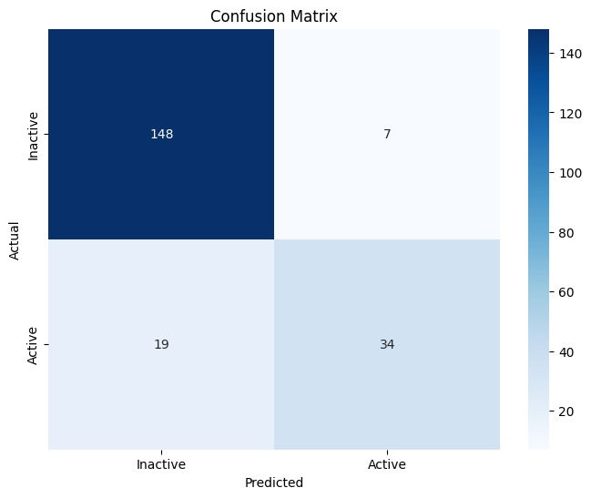

Slide 13
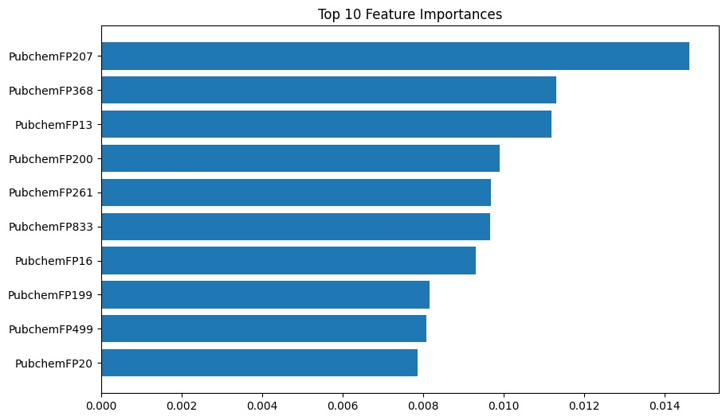
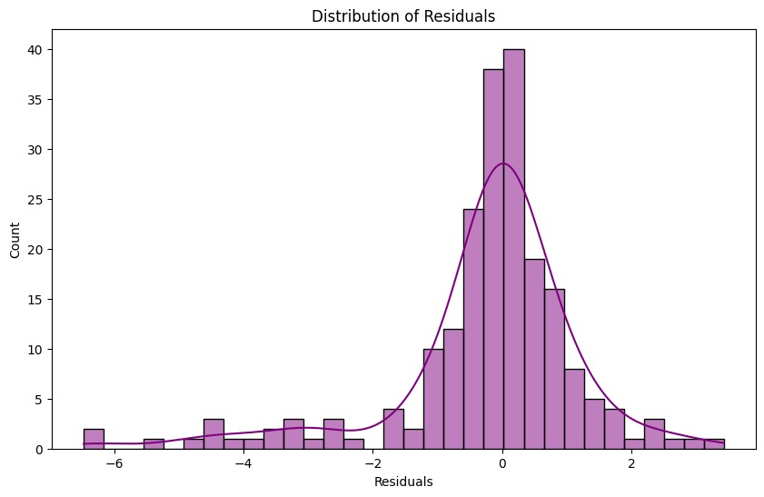
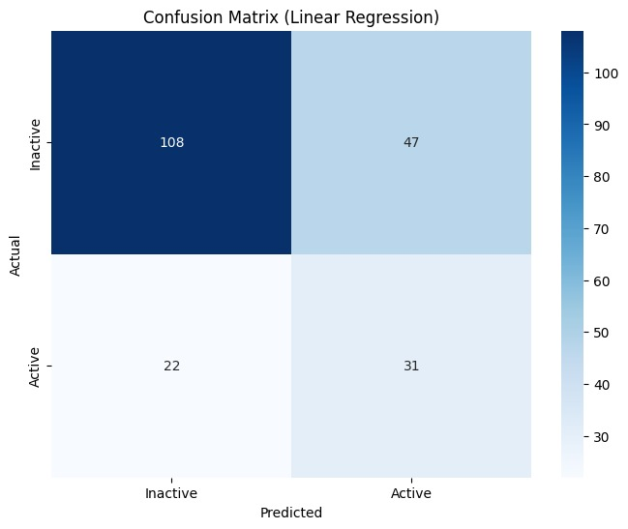
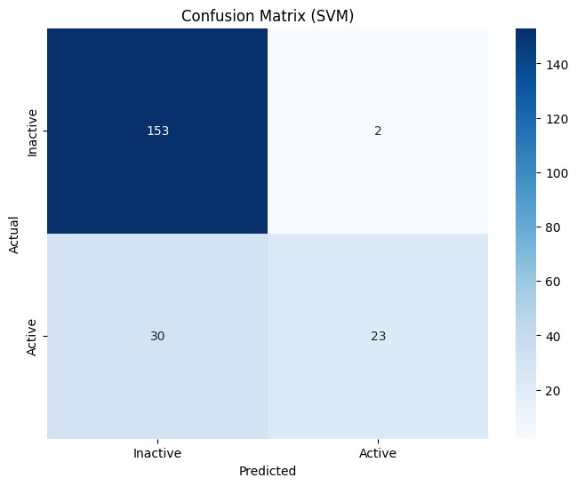

Slide 14
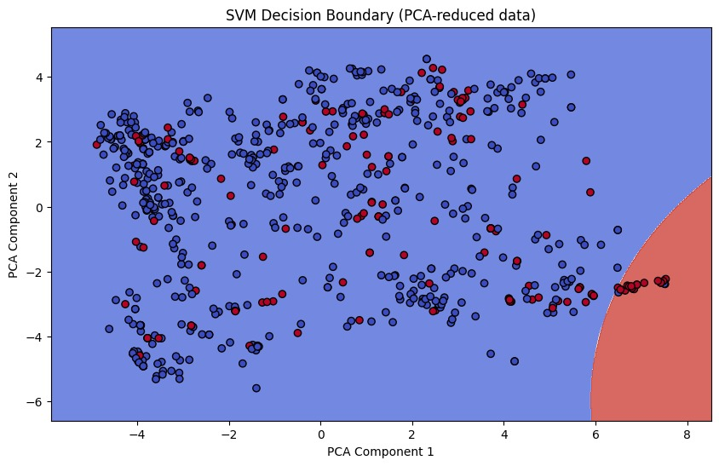
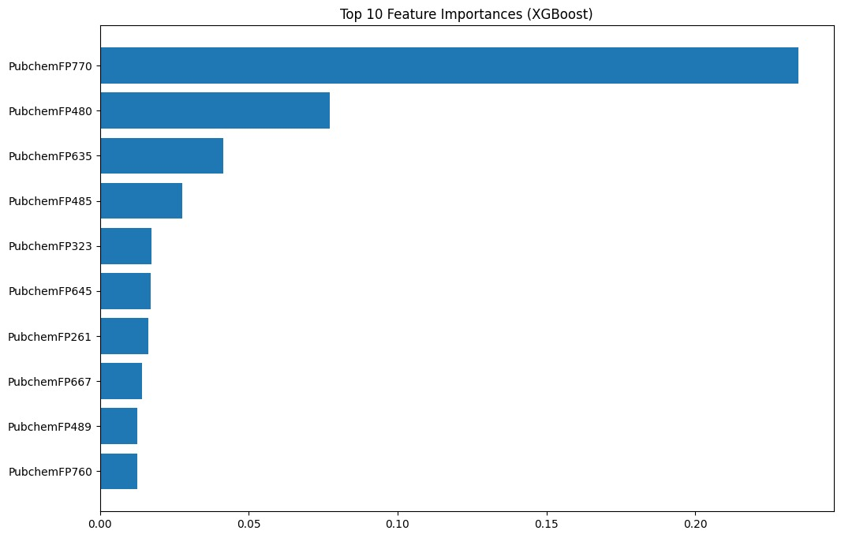
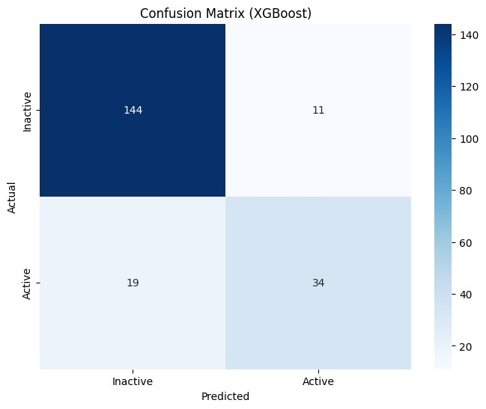

Slide 15

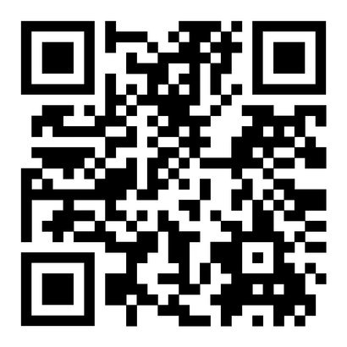
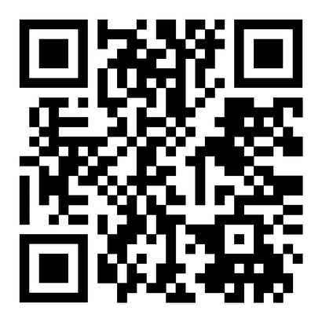
Papers
Application of artificial intelligence and machine learning in early detection of adverse drug reactions (ADRs) and drug-induced toxicity
Influence of artificial intelligence in modern pharmaceutical formulation and drug development
Exploring Artificial Intelligence in Drug Discovery: A Comprehensive Review

Slide 16

Question time?

Slide 17
Thank You
gu.edu.eg

